Slide 1
Team B - Final Presentation
Sudin Amatya, Abby Demers, Curtis Ellison, Joshua May, Connor McDonald

Slide 2
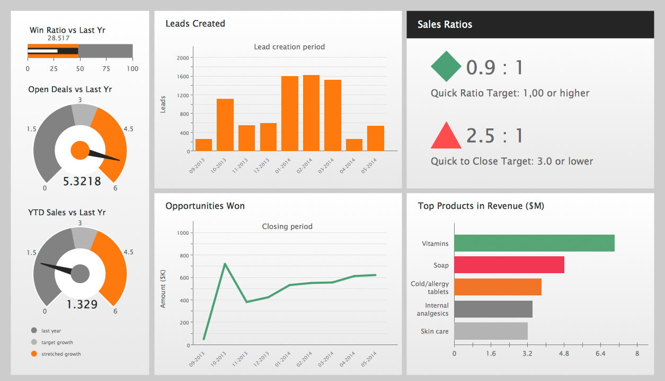
About
Creation of a visualization dashboard
Dashboard shows collaboration analytics
Uses game data
Fuses technologies and techniques
https://inst490-analytics-dashboard.herokuapp.com/
This Photo by Unknown Author is licensed under CC BY-NC-ND

Slide 3
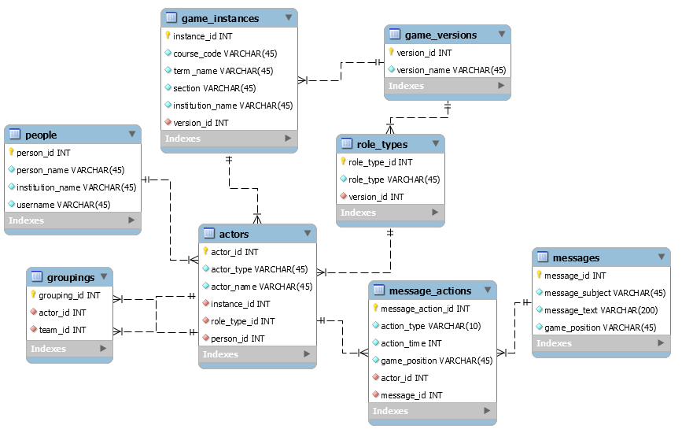
Development - Database
Created in MySQL Workbench
Focuses on message exchanges
People grouped into teams
Messages sent individually or as team
Manually Coded Test Data
https://inst490-analytics-dashboard.herokuapp.com/

Slide 4
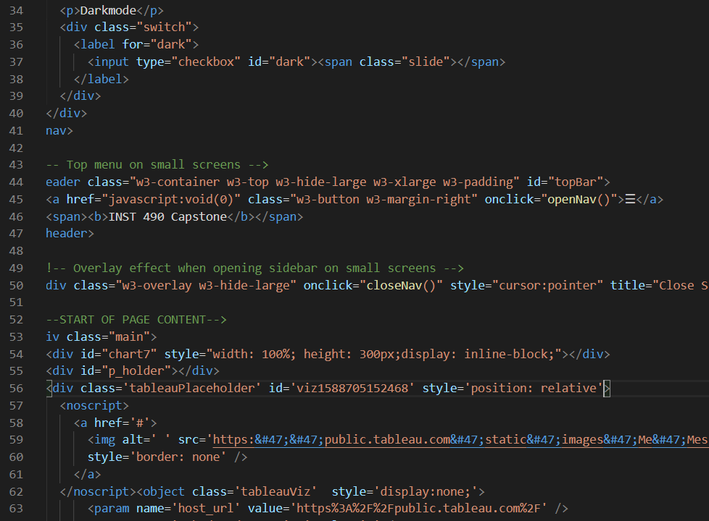
Development - Dashboard
Created in HTML
Uses JavaScript
Designed in CSS
Syncs with database
Facilitated through GitHub
https://inst490-analytics-dashboard.herokuapp.com/

Slide 5

Design
Wireframed in Paint and PowerPoint
Logo made in PowerPoint
Page designed wtih CSS
https://inst490-analytics-dashboard.herokuapp.com/
This Photo by Unknown Author is licensed under CC BY

Slide 6

Interpersonal Communication
GroupMe
Zoom
https://inst490-analytics-dashboard.herokuapp.com/
This Photo by Unknown Author is licensed under CC BY-SA

Slide 7
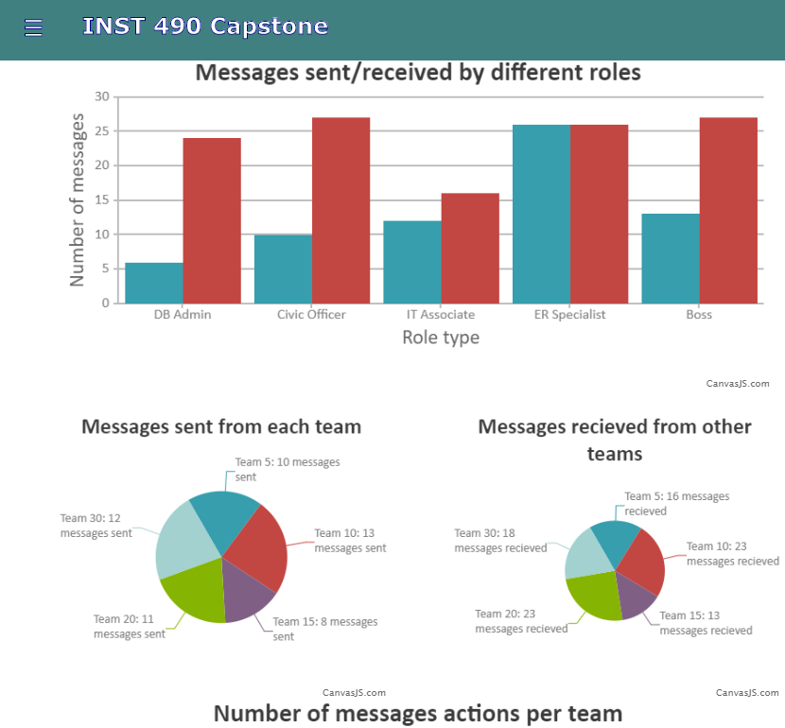
Deliverables
Interactive dashboard
https://inst490-analytics-dashboard.herokuapp.com/

